Slide 1
Exactly Protocol:
Financial Design and the Math Supporting it.
Francisco Lepone
math@exact.ly

Slide 2
What Ξxactly is?
Ξxactly is a Borrow & Lending protocol with a strong focus on bringing a solution to the fixed-rate, fixed-term market problem in blockchain.
Why?
Global Fixed Income Mkt size: ~ 127USD trill.
DEFI Mkt size: ~ 90USD bill.

Slide 3
Innovations Ξxactly brings to the DEFI ecosystem
Efficient Supply/Demand matching mechanism for fixed-rate, fixed-term credit.
New Interest Rate Model and Improved Liquidity Provision System that facilitates withdrawals.
Fair Cost Calculation for Credit Demand.
Solvency condition.
Multiple Utilization Rates.
Risk Model.
Dynamic Close Factor.

Slide 4
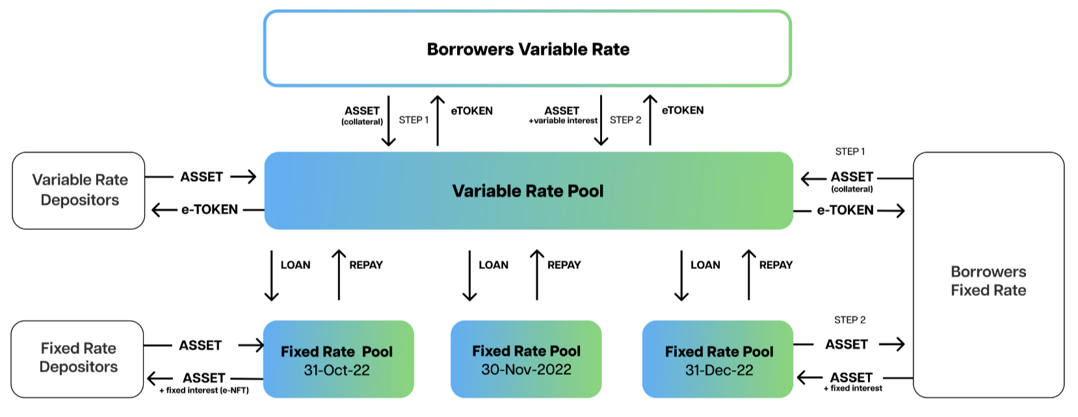

Innovations Ξxactly brings to the DEFI ecosystem
Efficient Supply/Demand matching mechanism for fixed-rate, fixed-term credit: By introducing two-types of liquidity providers, we can assure that credit demand for any maturity at any rate can be immediatly satisfied.
Interest
Funding
Borrows

Slide 5
Innovations Ξxactly brings to the DEFI ecosystem
Efficient Supply/Demand matching mechanism for fixed-rate, fixed-term credit: By introducing two-types of liquidity providers, we can assure that credit demand for any maturity at any rate can be immediatly satisfied.
Interest
Interest
Funding
Deposits
Borrows

Slide 6
Innovations Ξxactly brings to the DEFI ecosystem
New Interest Rate Model and Improved Liquidity Provision System that facilitates withdrawals: New Interest Rate Model given by a continuous and differentiable (non-linear) function with increasing speed of marginal cost plus the incorporation of a Liquidity Reserve.
Interest Rate Function:
Hard Liquidity Reserve ( RSS^{t} ):

Slide 7
Innovations Ξxactly brings to the DEFI ecosystem
Fair Cost Calculation for Credit Demand: Interest Rates for loans are determined based on the real change in the protocol state.
Effective Interest Rate to be applied to any single loan:

Slide 8
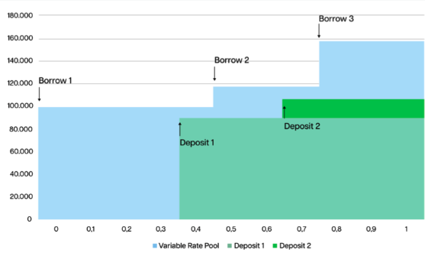
Innovations Ξxactly brings to the DEFI ecosystem
Solvency condition: Fixed interest rates for depositors are assured by previous borrowers that are ex-ante paying fixed interest rates.
Annualized Interest Rate for Deposits:

Slide 9
Innovations Ξxactly brings to the DEFI ecosystem
Multiple Utilization Rates: Flexible allocation of assets between Variable and Fixed Rates Pools according to the supply and demand of credit.
One Utilization Rate deals with the Variable Rate Pool
There is a specific Utilization Rate for each of the Fixed Rate Pools

Slide 10


Innovations Ξxactly brings to the DEFI ecosystem
Risk Model: Improves capital efficiency by increasing the lending power with risk adjusted collateral and debt for the health factor calculation.
Risk adjusted Collateral:
Risk adjusted Debt:
Liquidation Condition:
Restoring Condition:

Slide 11
Innovations Ξxactly brings to the DEFI ecosystem
Dynamic Close Factor: New liquidation process that returns the user to a solvency situation in a more efficient and equitable way.
Close Factor Function

